Slide 1


Naïve Bayes

Slide 2
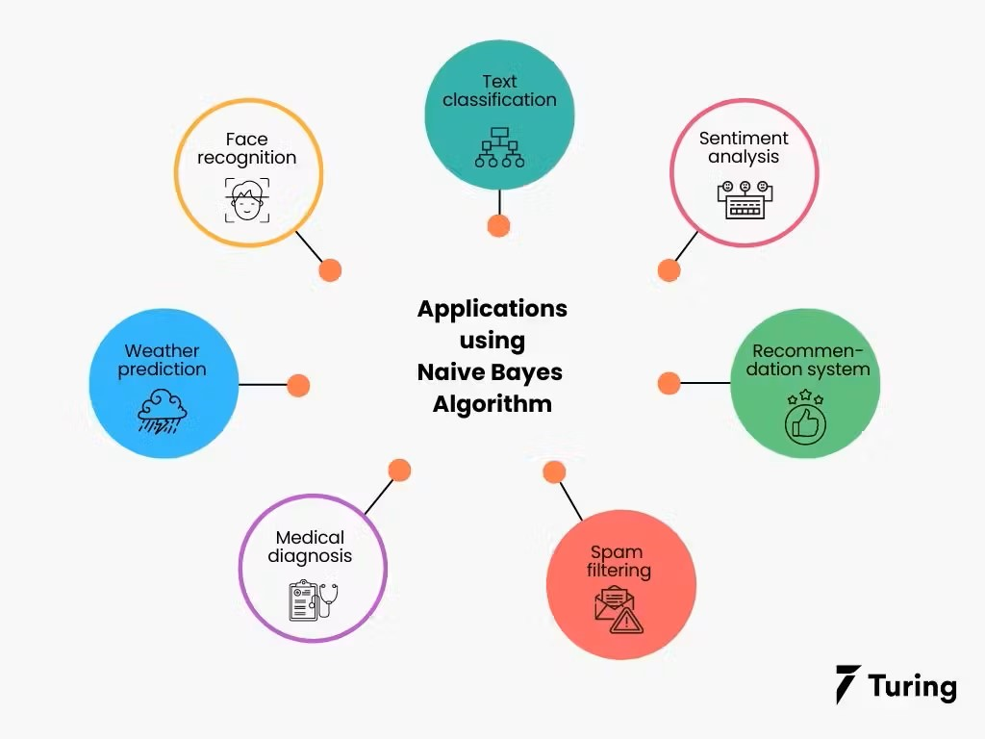
What is Naïve Bayes?
The Naïve Bayes classifier is a supervised machine learning algorithm that is used for classification tasks such as text classification.
Principle and Uses
They use principles of probability to perform classification tasks.
Naïve Bayes algorithm is used for classification problems. It is highly used in text classification. In text classification tasks, data contains high dimensions. It is used in spam filtering, sentiment detection, rating classification etc..

Slide 3
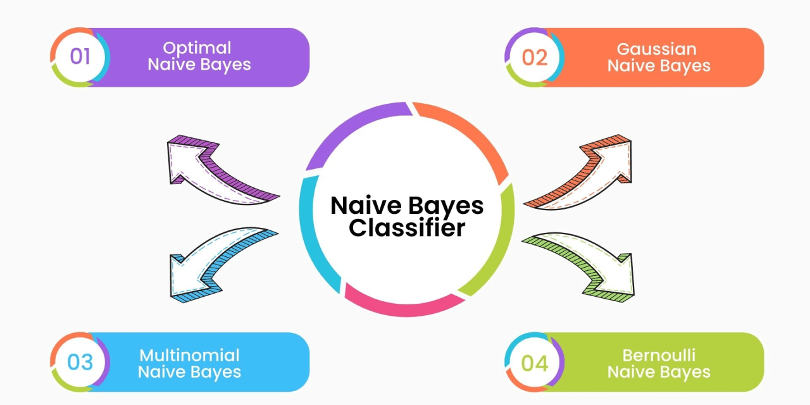
Types of Naïve Bayes
Gaussian Naïve Bayes
Multinomial Naïve Bayes
Bernoulli Naïve Bayes

Slide 4
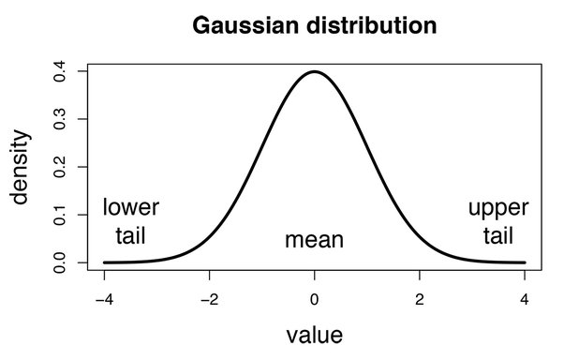
Gaussian Naïve Bayes
Gaussian Naive Bayes assumes that the features follow a normal (Gaussian) distribution.
For each feature, the algorithm estimates the mean and variance of the feature values within each class.
It then calculates the probability of a given feature value using the Gaussian probability density function.

Slide 5

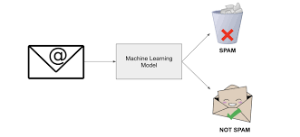
Multinomial Naive Bayes
Multinomial Naive Bayes is used for data where features represent the frequency or count of events.
It calculates the probability of each feature given a class by using the frequency of that feature within the class.
His variant is commonly used in text classification tasks such as spam detection or document categorization, where features are word counts or term frequencies in documents. For instance, it can classify emails as spam or not spam based on the frequency of certain words.

Slide 6
Bernoulli Naïve Bayes
Bernoulli Naive Bayes is designed for binary/boolean features that indicate the presence or absence of a feature.
It calculates the probability of each feature being present or absent within each class.
In a text classification task, it can be used to determine whether certain words appear in a document or not

